Slide 1

Where’s My Friends?
Find your friends without having to ask.
Team Surds

Slide 2
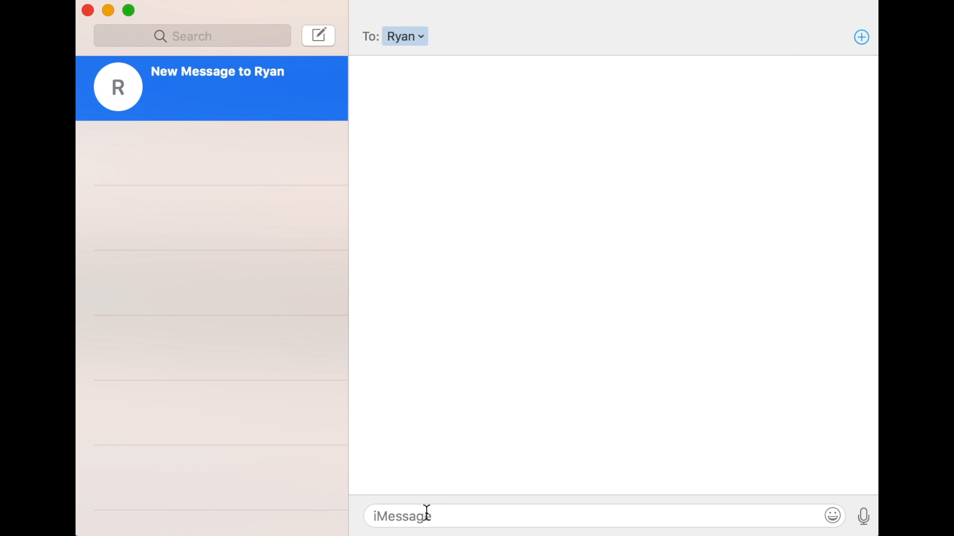

Slide 3
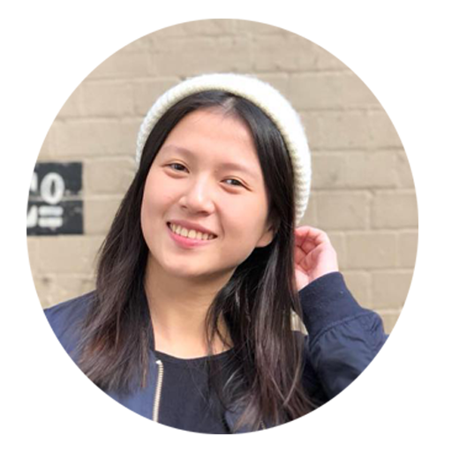
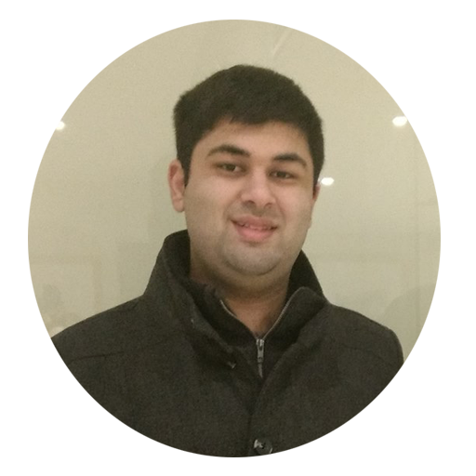
Kirsten and Ryan are friends.

Slide 4

Kirsten wants to study with Ryan.

Slide 5
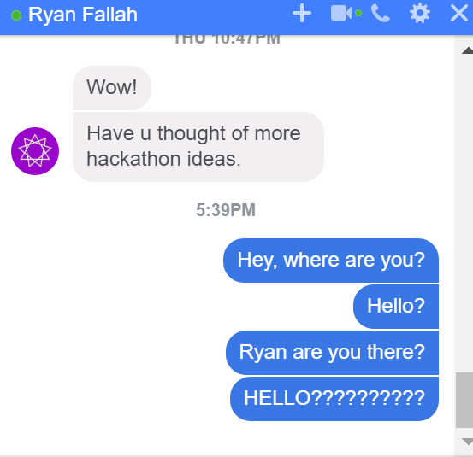
Kirsten asks Ryan where he is.

Slide 6






Ryan is deaf.
He doesn’t see the message.

Slide 7


Kirsten waits 30 minutes.
She doesn’t get a response.

Slide 8

Kirsten doesn’t get to study.
Ryan doesn’t get to study.

Slide 9

Kirsten doesn’t get to study.
Ryan doesn’t get to study.
They both drop out of university.

Slide 10

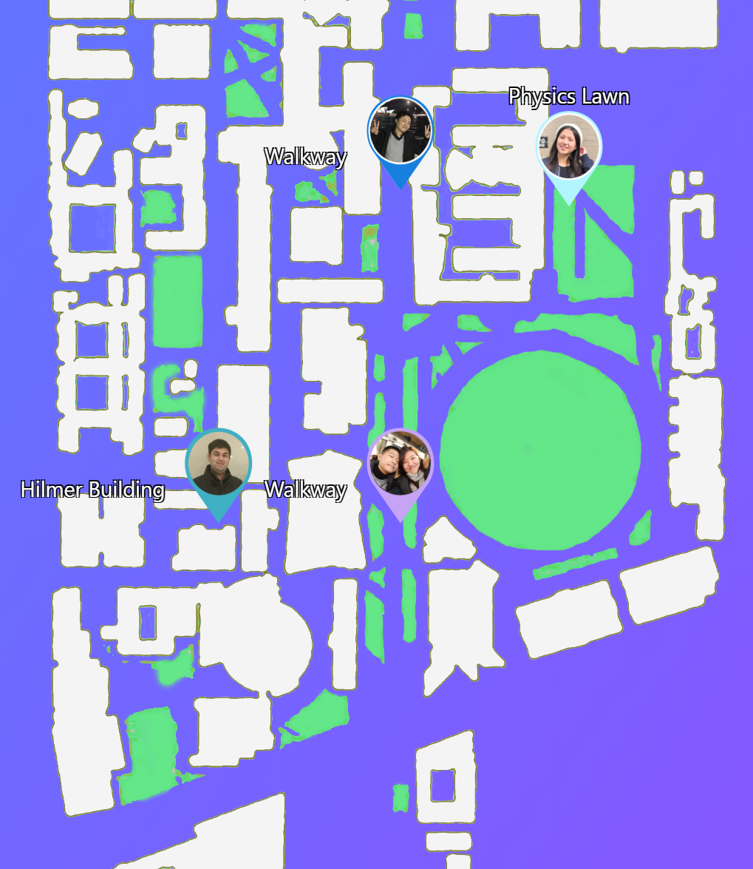
Where’s My Friends?
Find your friends without having to ask.

Slide 11
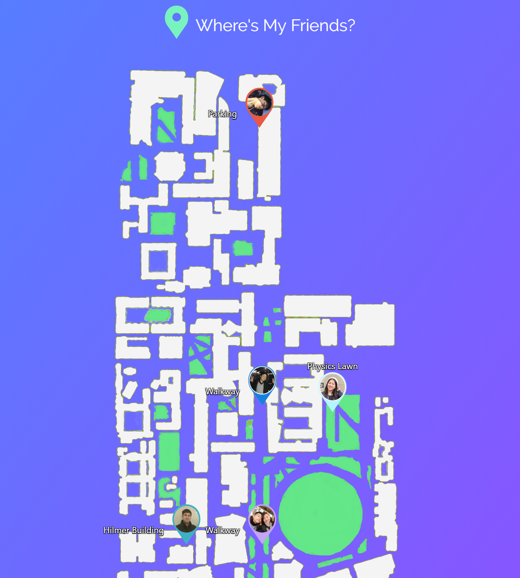
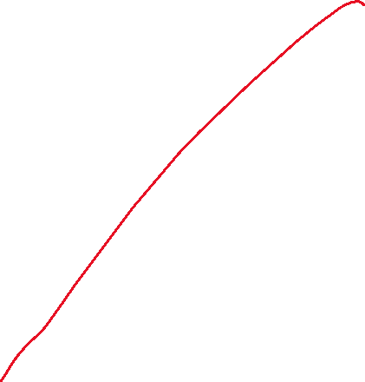

Easy to understand location of all of your friends!
Never wait for your friends to reply.

Slide 12
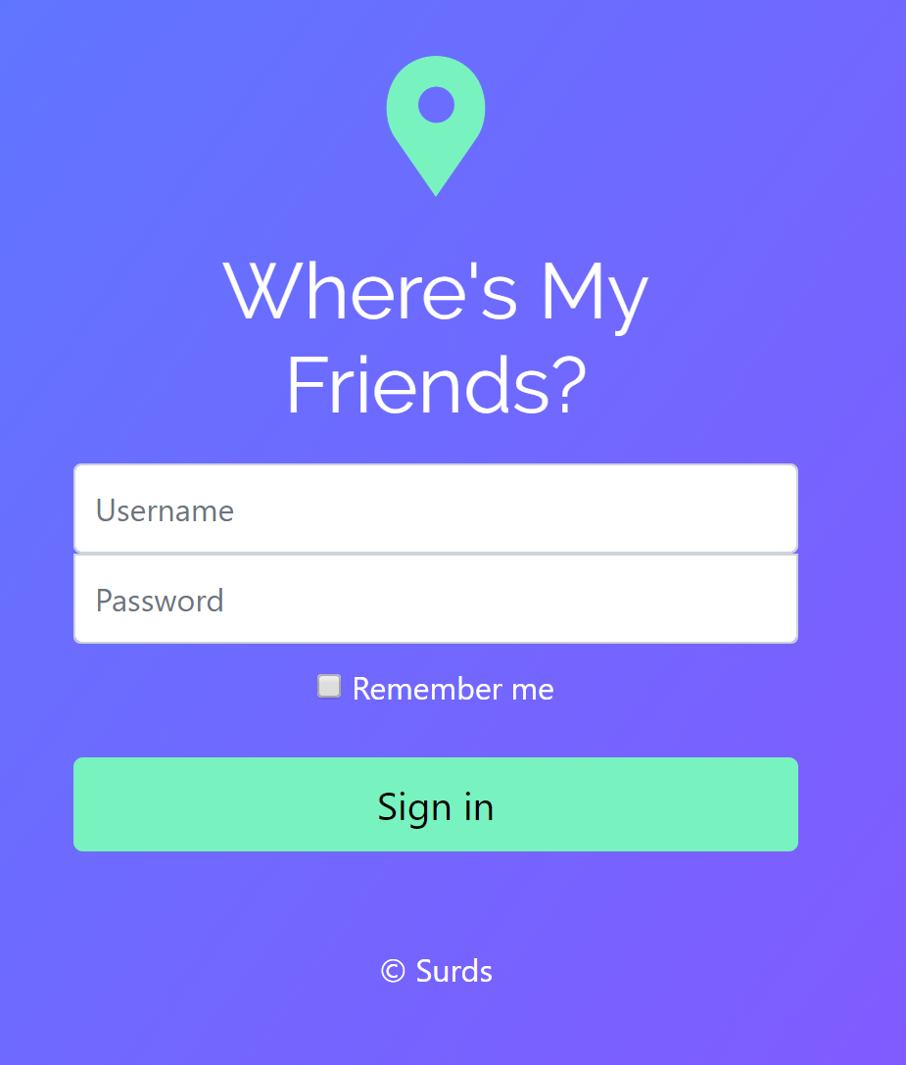
Secure Authentication
Don’t worry – only your friends are allowed to stalk you.

Slide 13
Time to Demonstrate!
It actually works.

Slide 14
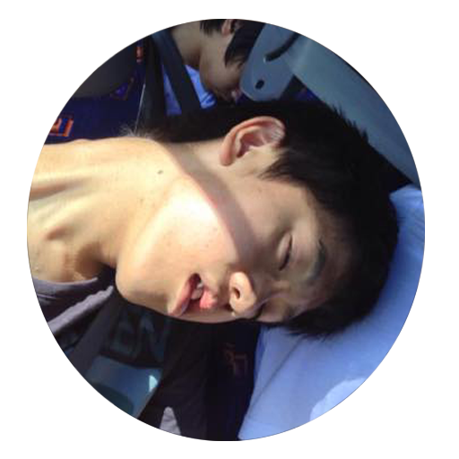
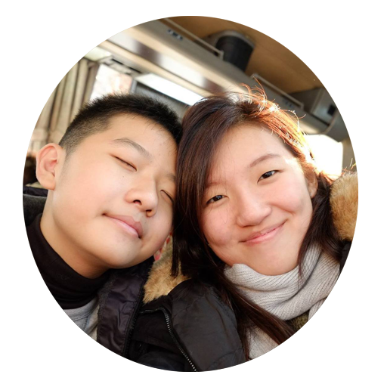
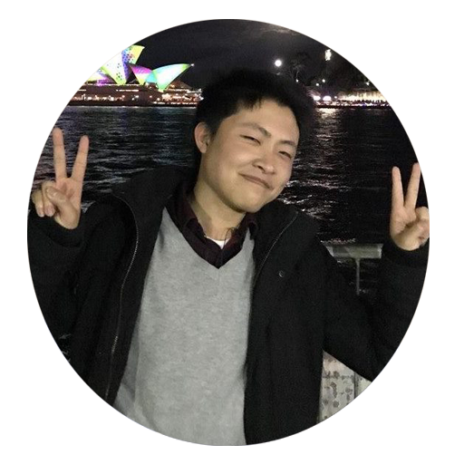
Team Surds
Kirsten
Richard
Natasha
Ryan
Tony

